Slide 1
Overview and Application of Common Social-Emotional Screeners
Northern Illinois University

Slide 2
How this came about…
Class Project: Social Emotional Assessment of Children; Instructor: Michelle Demaray
Thanks to our presenters today. The presenters are all second year school psychology students at Northern Illinois University:
Stephanie Secord
Kelly Lyell
Nicole Smit
Carlota Rodelo-Bristol
Ericka Allen
Lyndsay Jenkins
Amy Magers
Andrea Setmeyer

Slide 3
Social Emotional Issues in Schools
Prevalence of social emotional issues in schools
.8% of students are in special education for Emotional Disturbance/Behavior Disorder
20% of students have mental health issues that need attention and many are not getting services
Role of Schools
Response to Intervention – focus on prevention, universal screening, tiered service delivery
Role of School Psychologists

Slide 4
Social Emotional Issues in Schools
There is a significant need in schools to improve efforts at screening and identification of students with emotional and behavioral problems
(Caldarella et al., 2008; Chafouleas, Kilgus, & Wallach, 2010; Gresham, 2007)
Although many schools are screening for academic deficits, screening for behavior is lagging behind academics
For externalizing behavior problems, schools often rely on office discipline referrals
Prone to poor reliability (Kalberg et al., 2010)
Lack internalizing problem data

Slide 5
Goal
The goal of this mini-skills session is to critically review and evaluate five social/emotional and behavioral screeners and one online web-based system.

Slide 6
How the Measures were Chosen
Informally surveyed practitioners, PSYCINFO searches, and searches via test publishing companies
Required:
Use in elementary and/or secondary school population
Needed to include both externalizing and internalizing/social behavior problems
Needed to have some evidence of validity/reliability

Slide 7
Measures Reviewed
Systematic Screening for Behavior Disorders
(SSBD; Walker & Severson, 1992)
Behavioral and Emotional Screening System
(BESS; Kamphaus & Reynolds, 2007)
Social Skills Improvement System Performance Screening Guide
(SSIS; Elliott & Gresham, 2008)
AIMSweb Behavior
www.aimsweb.com
Conners Clinical Index Screener
(Conners CI; Conners, 2008)
Strengths and Difficulties Questionnaire
(SDQ; Goodman, 1997)

Slide 8
Areas Reviewed
Content and Use (i.e., a description of the measure, scoring procedures, rating format)
Standardization Sample and Norms (i.e., norming procedures, description of normative sample)
Scores and Interpretation (i.e., scores obtained and information on interpretation)
Psychometric Properties (i.e., evidence of reliability -internal consistency, test-retest, and interrater reliability, and validity - test content, convergent validity, and divergent validity)
Critical Review of Advantages and Disadvantages
Notes:
Note: Please also refer to the handouts. They have detailed information not in the powerpoint slides.

Slide 9
Systematic Screening for Behavior Disorders; SSBD
Walker & Severson, 1992
Presented by Stephanie Secord

Slide 10
SSBD: Overview
Three-stage, gated screening system that identifies students with internalizing and externalizing behaviors.
Stage 1: Teacher Screening
Stage 2: Teacher Ratings
Stage 3: Behavioral Observation
Intended for elementary-aged students
Completed by teachers and school psychologists (or other school professional)
Notes:
Although one study has used the SSBD with a middle school sample.

Slide 11
SSBD: Cost
Cost: $130
SSBD includes:
User’s Guide
Administration Manual
Observer Training Manual
including a video tape and cassette tape
Technical Manual
Reproducible forms used in Stages 1-3

Slide 12
Administration: Stage One
Completed by teacher
Identify and rank order students that display internalizing and externalizing behaviors
10 students each
Rank order the students based on severity of behavior

Slide 13
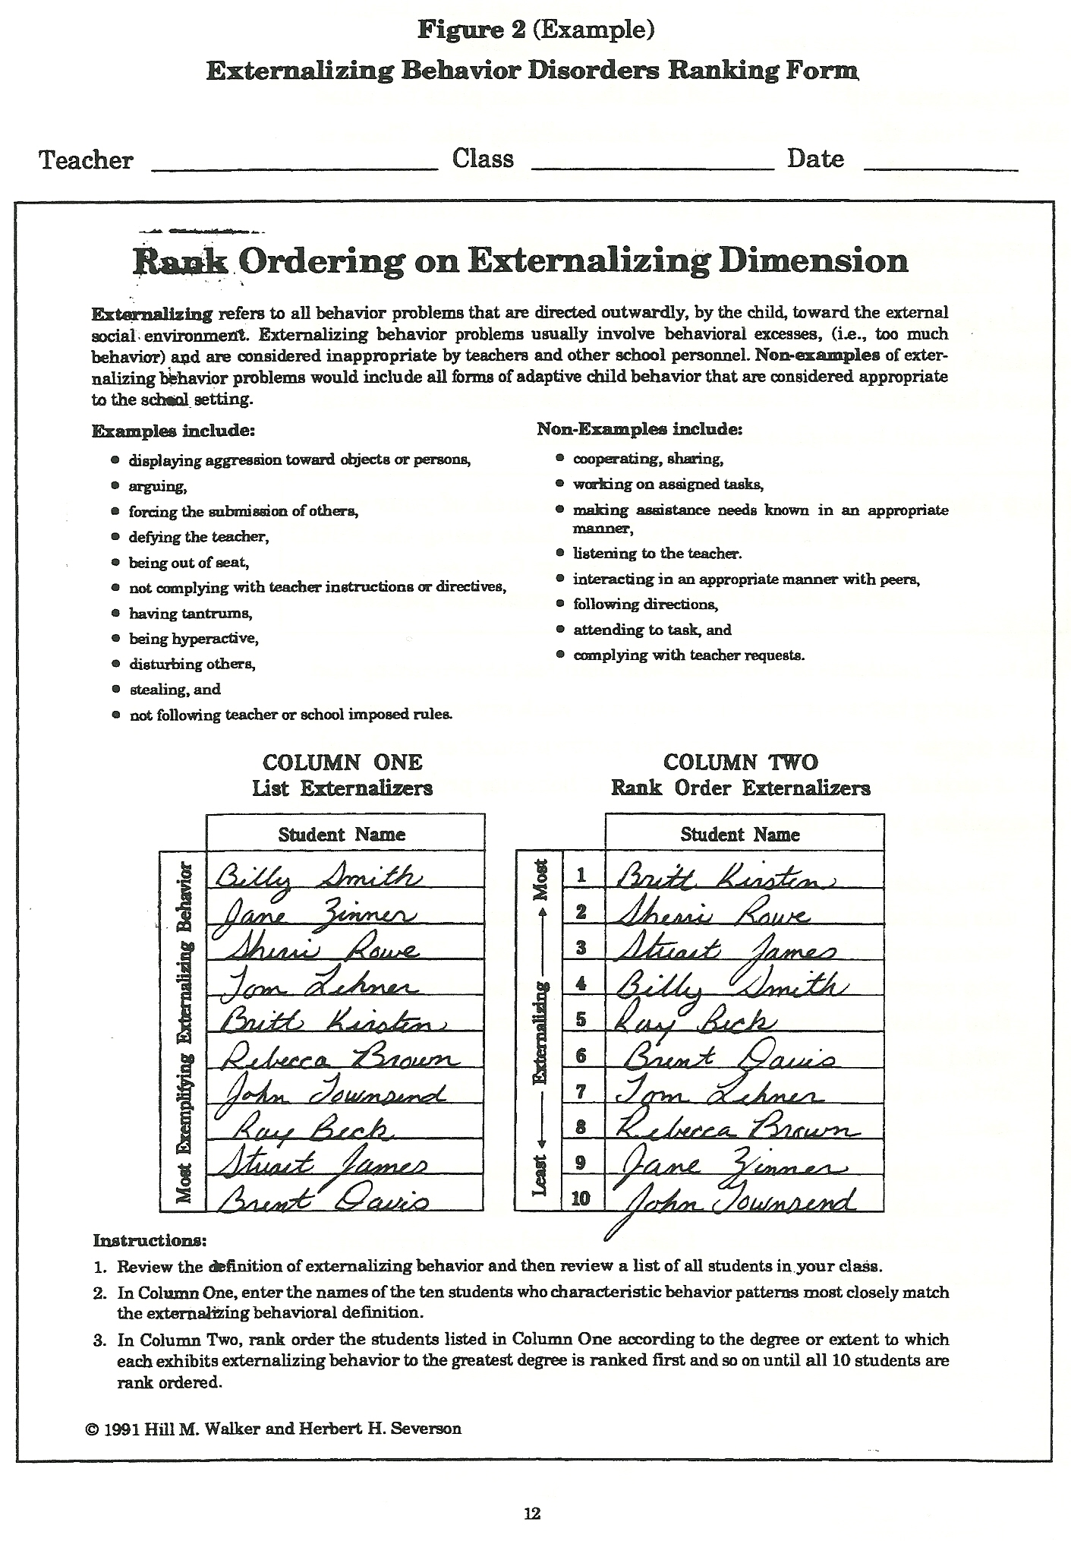

Slide 14
Administration: Stage Two
Teacher completes two measures on the top three ranked students on each list
Critical Events Checklist
33 externalizing and internalizing behaviors
Past 6 months
Combined Frequency Index
5-point Likert scale ranging from 1 (never) to 5 (frequently)
12 adaptive behaviors
11 maladaptive behaviors
If scores on the checklists exceed normative criteria and cutoff scores, student moves on to Stage Three
Notes:
Assesses whether the student has exhibited any of 33 externalizing or internalizing behaviors in the past 6 months

Slide 15
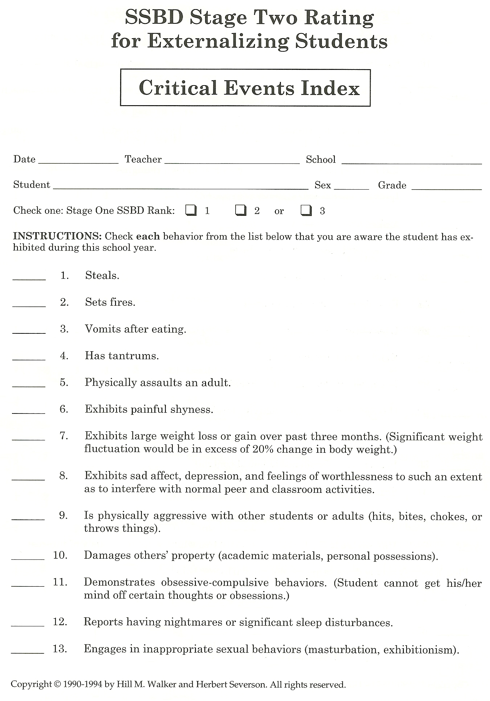

Slide 16
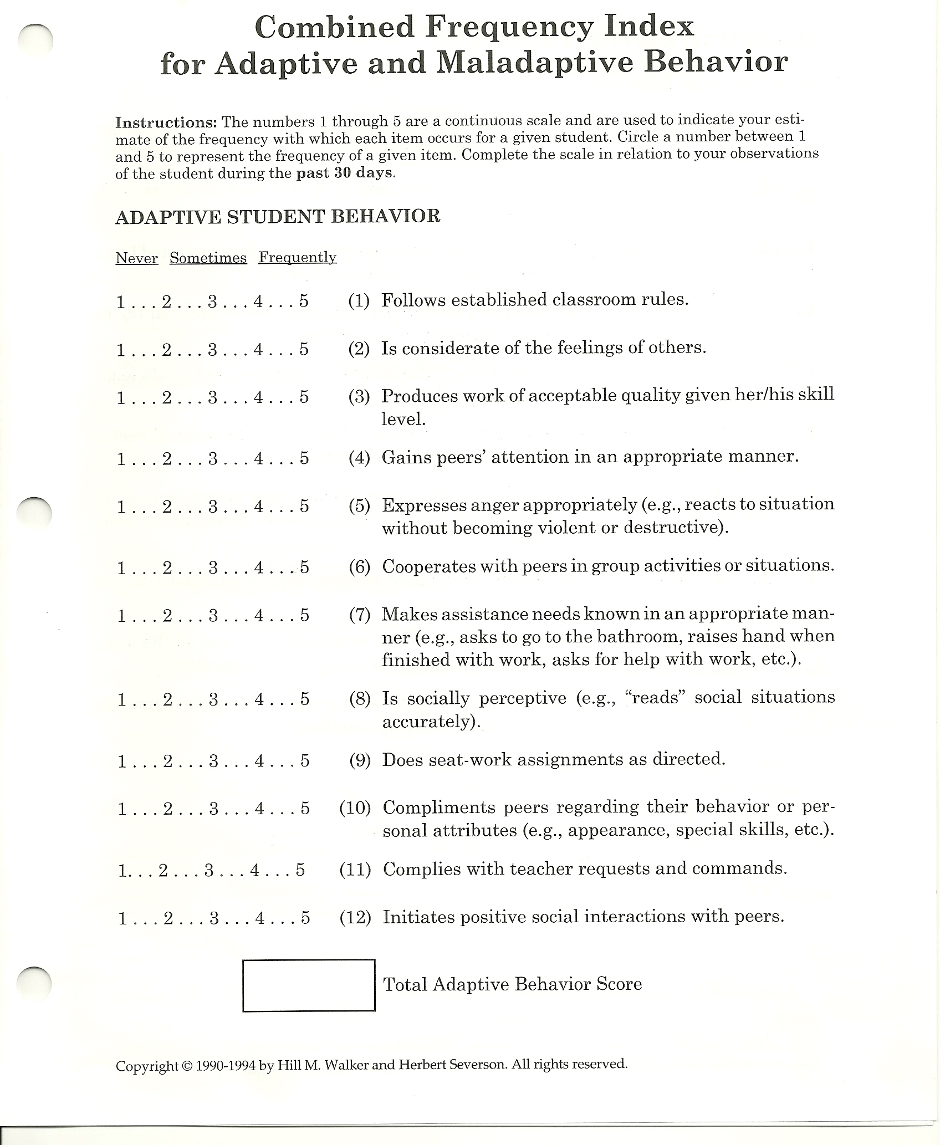

Slide 17
Administration: Stage Three
Observations completed by school psychologist, or other trained school professional
Academic Engaged Time Observation
Two 15-20 minute independent seatwork periods
Record amount of time student is academically engaged
Peer Social Behavior Observation
Assess student’s social behavior during recess
Social Engagement, Participation, Parallel Play, and Alone
Notes:
Peer Social Behavior Observation is also during 2 15 minute observations.

Slide 18
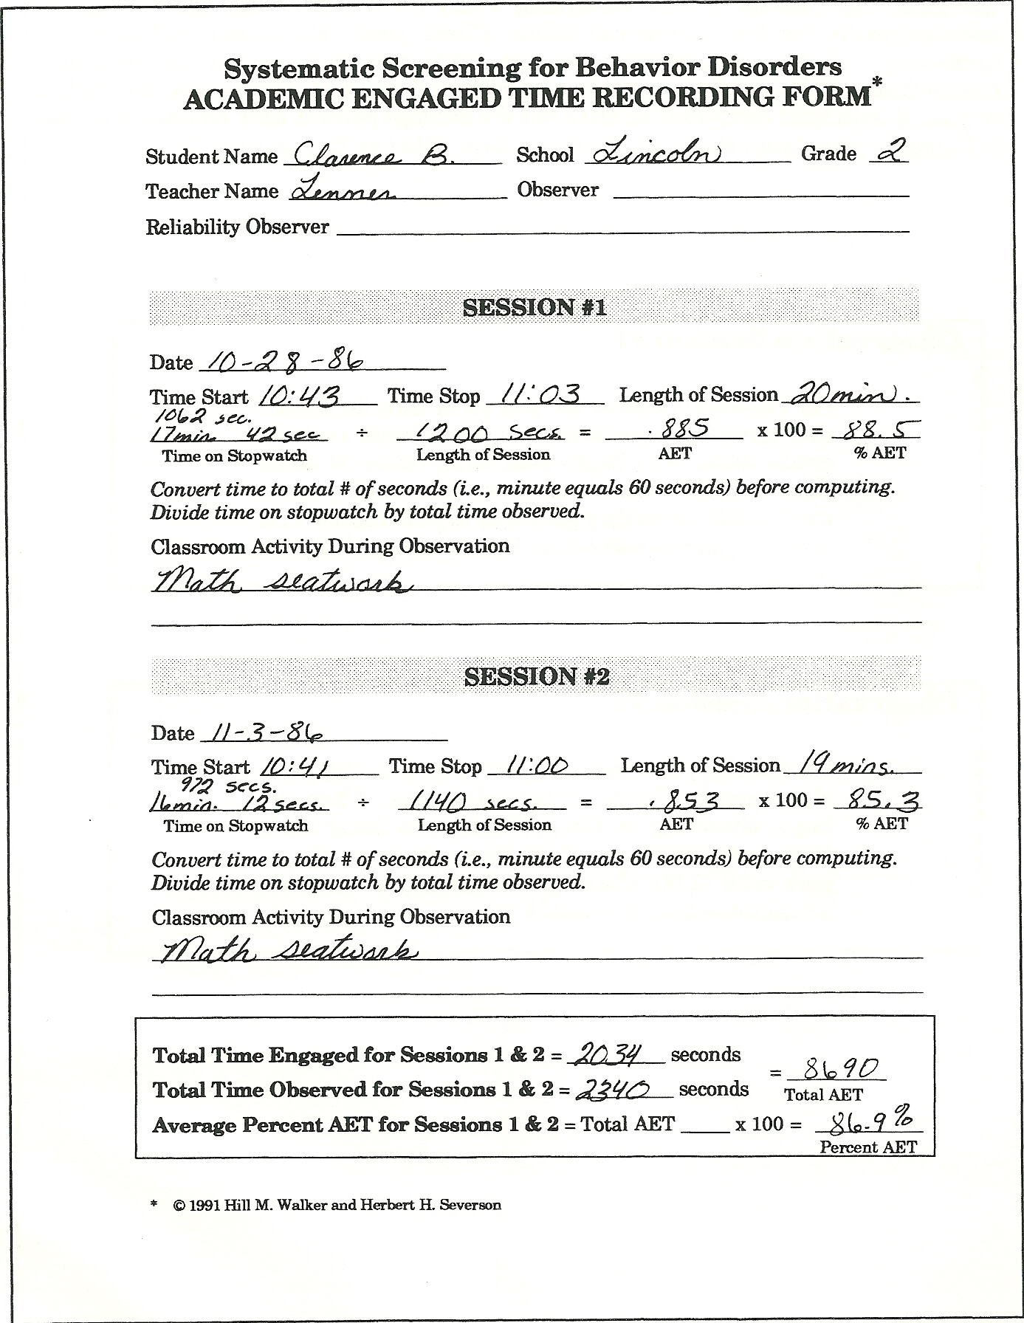

Slide 19
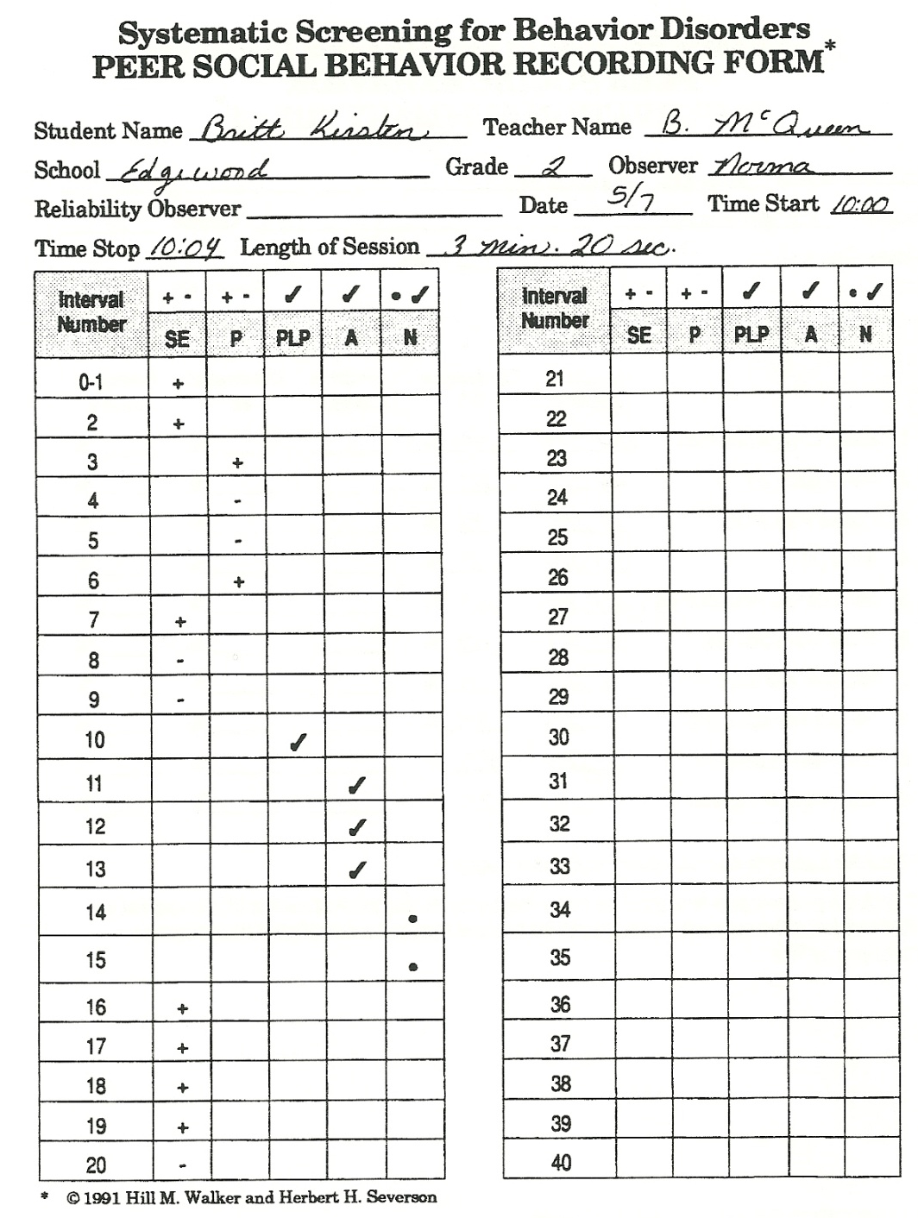

Slide 20
Peer Social Behavior Observation
Participation
Target child is participating in a game or activity (with 1 or more children) that has a clearly specified and agreed upon set of rules.
Social Engagement
Physically oriented toward another child
Exchanging social signals of reciprocal, purposeful nature with them
Produces verbal behavior
Notes:
Examples of participation: dodgeball, soccer, hop-scotch, etc. Non-examples would be tag, jump rope, follow the leader (they are unstructured)

Slide 21
Example: “Drew”

Slide 22
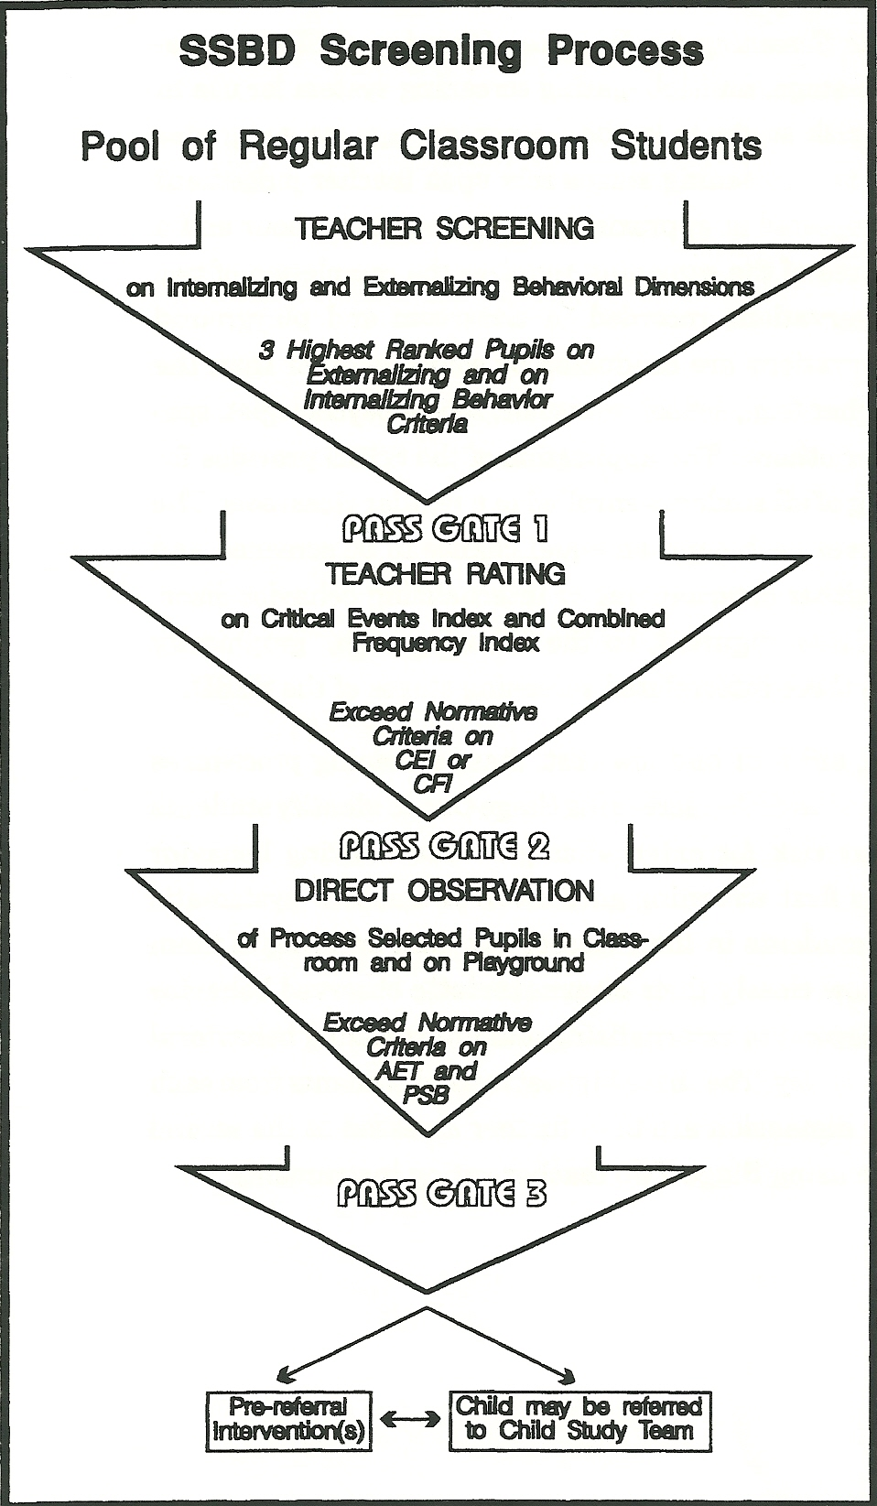

Slide 23
Standardization and Norms
Little information is presented in the manual regarding the standardization sample.
Participants were from diverse geographical regions.
18 school districts located in 8 states across the country
Stage 2 Measures (n= 4,463)
Stage 3 Measures (n= 1,275)
Norms are available for all measures at Stages 2 and 3 by grade and gender
Ethnicity and gender not reported

Slide 24
Psychometric Properties
Please refer to handout for specific numbers
Internal Reliability | Excellent
Test-Retest Reliability | Excellent
Inter-rater Reliability | Excellent
Convergent/Divergent Validity | Limited to Excellent

Slide 25
SSBD: Advantages
The system closely aligns with the three-tier service delivery system of RTI.
Strong reliability and validity evidence, as well as endorsements from experts in the field
Identifies students who may be under-identified (i.e., students with internalizing behaviors)
Manual provides reproducible forms

Slide 26
SSBD: Disadvantages
Quite complex, with the different stages, forms, raters, and observers.
Substantial training may be required
Parents are not involved in any of the stages
Does not allow teachers to identify students who display both internalizing and externalizing behaviors
May be time consuming for teachers
Does not allow for progress monitoring

Slide 27
BASC-2 BEHAVIORAL AND EMOTIONAL SCREENING SYSTEM; BASC-2, BESS
Kamphaus & Reynolds, 2007
Presented by Carlota Rodelo

Slide 28
BESS: Overview
Norm referenced rating scale based on the Behavioral Assessment System for Children, Second Edition
Designed to screen for a variety of problems (i.e., externalizing, internalizing, and school) and strengths (i.e., adaptive skills), using one Total Score
Designed for children and adolescents (ages 3-18), and to obtain information from parents and teachers
Part of AIMSweb Behavior system

Slide 29
BESS: Cost
Initial cost of the system to screen a school of 500 students once: $1,152.65
Cost includes:
Manual: $63.65
Student Forms: $500 ($100 for package of 100 forms)
Scoring ASSIST software = $589
Add $500 for each additional informant used
$100 for package of 100 parent forms
$100 for package of 100 teacher forms
Subsequent screenings: $500 (cost of student forms)

Slide 30
BESS
Sample questions:
Pays attention (T-Form)
Is well organized (T-Form)
I am good at making decisions (S-Form)
Even when I try hard, I fail (S-Form)
Worries (P-Form)
Tries to bring out the best in other people (P-Form)

Slide 31
BESS: Administration
Approximately 5 minutes to complete
Individual or group
All students or a subset
Every other grade
New students
Not designed for individual progress monitoring
Three forms, 25-30 items each
Student, one form, grades 3-12
Teacher and Parent, two forms each
Preschool (ages 3-5)
Child/adolescent (grades K-12)

Slide 32
BESS: Scoring
Responses made on a frequency-based, 4-point rating scale of Never, Sometimes, Often, Almost Always (N, S, O, or A)
Written at approximately a sixth-grade reading level for parents, second-grade reading level for students
Responses can be scanned or hand-typed and scored using the BASC-2 Assist Software
Hand scoring also possible, but not recommended for large groups

Slide 33
Scoring and Interpretation
Items summed to get one Total Score
Raw scores, T scores (M = 50, SD = 10), and percentile ranks provided in manual
Classification (based on T scores)
40-60: Normal Range
61-70: Elevated risk
71+: Extremely Elevated risk
Validity indexes included for more accurate interpretations
Consistency and Pattern Response Indexes
F Index for Parent and Teacher forms

Slide 34
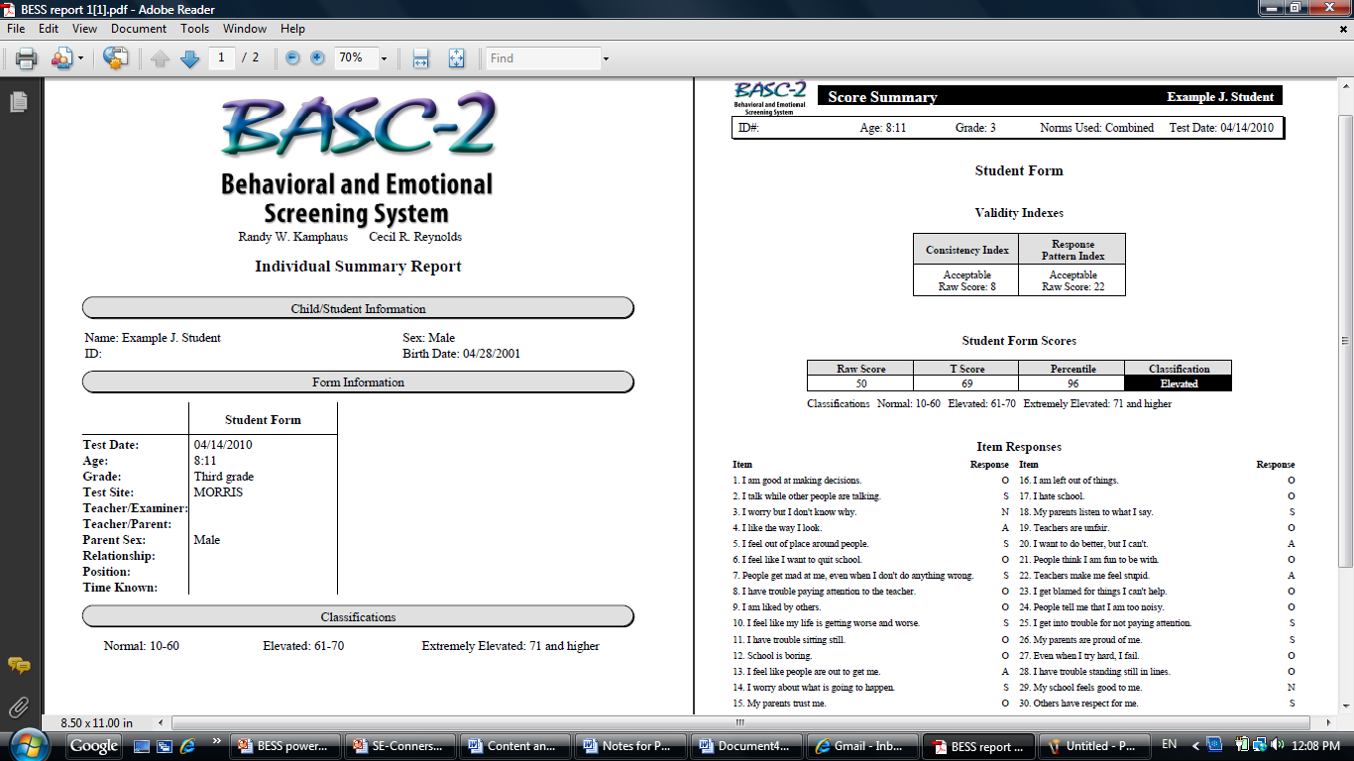
Sample Individual Report

Slide 35
Sample Class Report

Slide 36
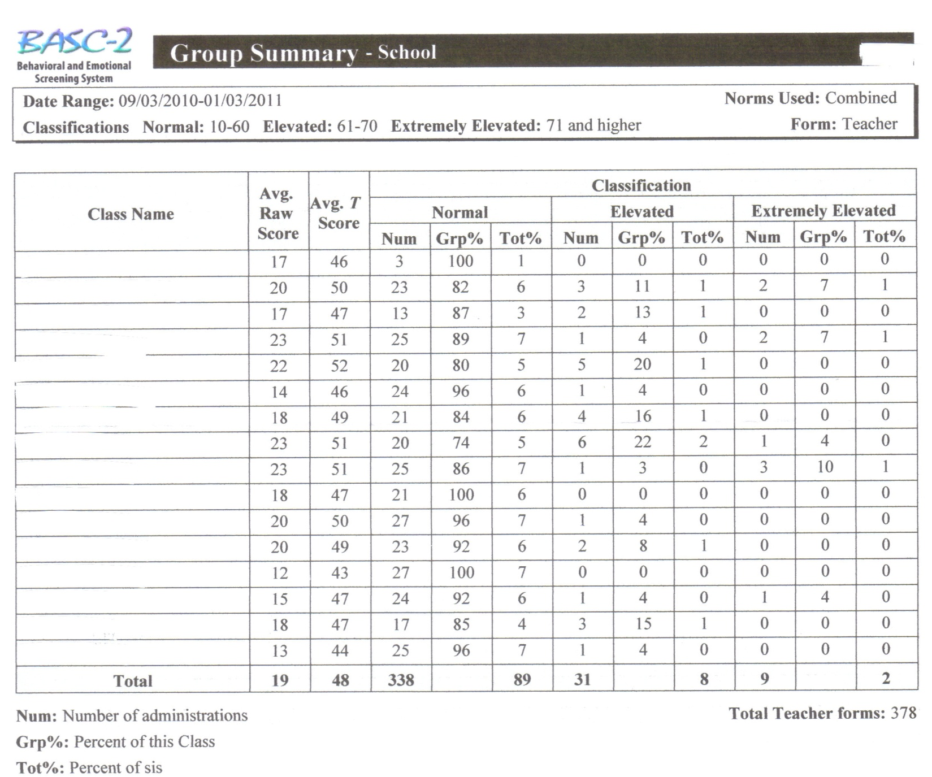
Sample School Report

Slide 37
Standardization and Norms
Excellent normative sample
Developed using the BASC-2 item pool
n=12,350
Representative of U.S. population
Taken from 233 cities across 40 states
Child and adolescent ages ranged from 3 to 18
Separate norm groups based on age within each form level
Two age groups at the Preschool level (age 3 and ages 4-5)
Three age groups at the Child/Adolescent level (ages 5-9 (8-9 for Student Form), ages 10-14, and ages 15-18)

Slide 38
Psychometric Properties
Please refer to handout for specific numbers
Internal Reliability | Excellent
Test-Retest Reliability | Excellent
Inter-rater Reliability | Adequate
Convergent/Divergent Validity | Limited to Excellent

Slide 39
BESS: Advantages
Objective and systematic screening system
Created to contain equal amounts of positively and negatively worded items to capture both strengths and weaknesses
Forms brief and easy to administer for a reliable and accurate Total Score that is predictive of behavioral and emotional problems
Validity indexes further add to the accuracy and utility
Part of larger BASC-2 system, which provides further evaluation and intervention suggestions after screening
Also part of AIMSweb Behavior
Audio recordings and Spanish forms available of the parent and student forms

Slide 40
BESS: Disadvantages
Reason for caution when it comes to screening for internalizing problems, especially among younger children (based on validity data)
Potentially high cost
Not useful as a progress monitoring tool
For teachers with multiple students can be time consuming at 5 minutes per student

Slide 41
BESS: User Comments
I'm really glad we started using the screener. I especially like it because it catches the internalizing students who usually go unnoticed. It also helps at re-eval time because I can easily pull up the data and, as the years go on, we will start seeing reliable trends, instead of subjective notes from teachers.
The teachers grumble about it because there are so many bubbles to fill out. We have found that the older students can (usually) fill out the bubbles themselves before the teacher completes it. They have also had aides help them bubble to cut down on time. I'm hoping we can purchase the Aimsweb version and that it will be more user friendly!

Slide 42
Social Skills Improvement System Performance Screening Guide; SSiS
Stephen N. Elliott, PhD & Frank M. Gresham, PhD
Presented by Nicole Smit

Slide 43
SSiS: Overview
Screening component of the SSiS Multi-tiered Assessment and Intervention Model
Collects class-wide data on students’ academic performance and learning behaviors that influence performance
Standardized, criterion-referenced rating scale
Available for three levels: preschool, elementary, and secondary
Included in AIMSweb behavior

Slide 44
SSiS: Cost
10 booklets (elementary & secondary) = $42.50
4 booklets (preschool) = $17.00
SSiS Rating Scales Manual = $104.05
Cost to screen 500 elementary students (20 classrooms) = $189.05
Notes:
The rating scales manual is where you’ll find information on the performance screening guide.
In my cost estimate, I assumed each of the 20 classrooms has 25 students.
For subsequent screening, you’d just have to pay for additional booklets.

Slide 45
SSiS: Administration
Completed by classroom teachers
Average completion time: 30 minutes for entire class
Teachers rate students 1-5 in four areas:
Positive social behaviors
Motivation to learn
Reading skills
Math skills
Descriptions of the behaviors or skills at each of the 5 levels are described in the booklet
Note: The preschool booklet rates students using 4 levels instead of 5.

Slide 46
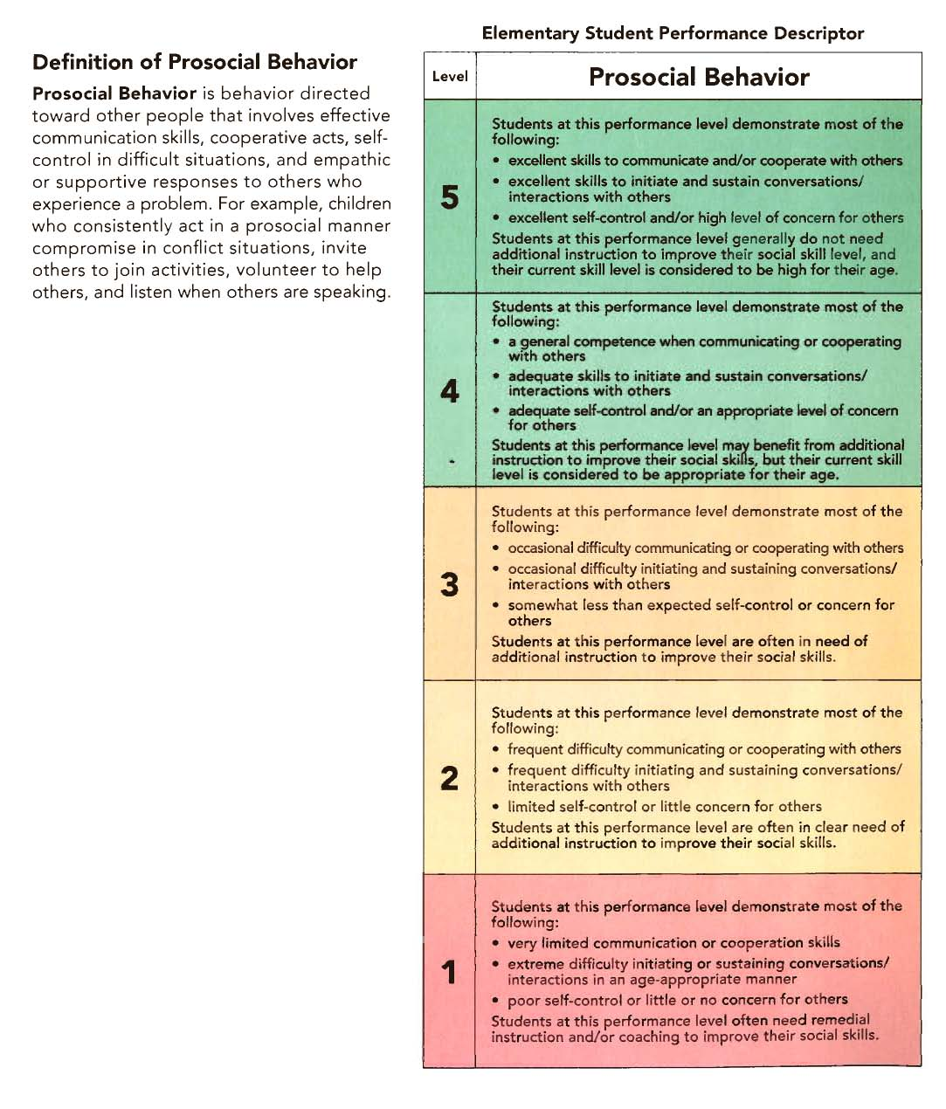

Slide 47
Scoring and Interpretation
The Screening Guide provides a brief statement about how much intervention, if any, is indicated by each performance level
1 = high level of concern; intervention needed.
2 or 3 = moderate concern
4 or 5 = student is functioning at or above the level expected of students their age

Slide 48
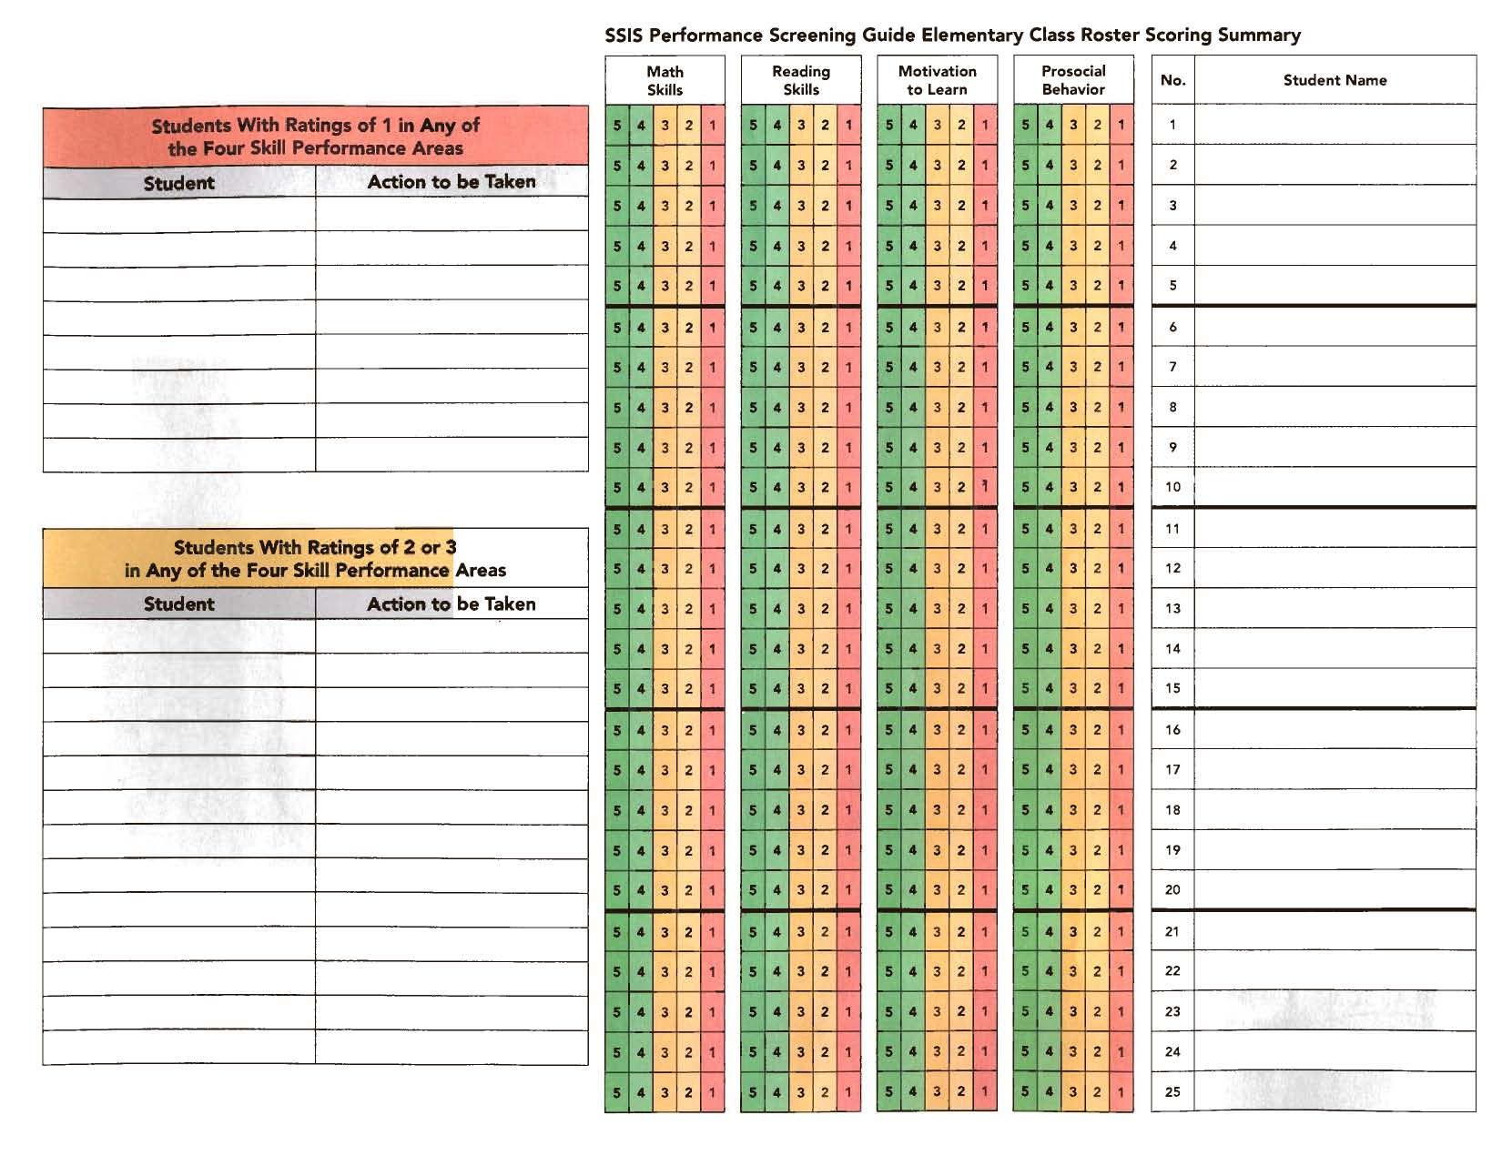
Notes:
Color-coding system: Level 1 is red, levels 2 and 3 (2 for preschoolers) are yellow, and levels 4 and 5 (3 and 4 for preschoolers) are green.
Sections provided to write the names of students with ratings of 1, 2, or 3. This is also where the rater can briefly record actions to be taken in regards to intervention for the students with low ratings.

Slide 49
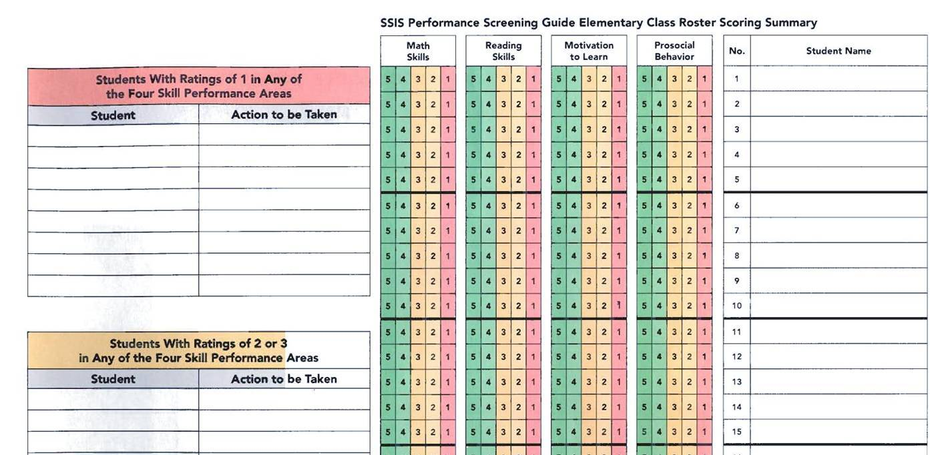
Andrea Setmeyer
Ericka Allen
Andrea Setmeyer Tier 3 Math Intervention
Amy Magers
Stephanie Secord Tier 3 Rdg Intervention
Stephanie Secord
Amy Magers Progress Monitor Math
Amy Magers Social Skills Group

Slide 50
Standardization and Norms
Development and field testing of the SSiS Performance Screening Guide occurred during the standardization of the SSiS Rating Scales
Teachers n = 138
30 preschool, 76 elementary, and 32 high school
Majority female n = 126
Majority was taken from the North Central and South regions of the U.S. (n = 45, n = 52)
Students evaluated n = 2,497
Preschool n = 439
Elementary n = 1,475
Secondary n = 538

Slide 51
Psychometric Properties
Internal Reliability | Not provided
Test-Retest Reliability | Adequate (elem. & sec.) Limited (preschool)
Inter-rater Reliability | Adequate
Convergent/Divergent Validity | Limited to Excellent (elem. & sec.) Adequate to Excellent (preschool)
Please refer to handout for specific numbers
Notes:
Validity is variable
“In terms of evidence for psychometric properties…..”

Slide 52
SSiS: Advantages
Standardized, criterion-referenced screener of key social, motivational, and academic behaviors
Time-efficient (30 minutes or less)
Scoring and interpretation are easy and straightforward
Distinct behavioral criteria for each of the four skill areas and performance levels are provided in the booklet
Direct link to intervention: SSiS Classwide Intervention Program
Fairly inexpensive
Teachers indicated that the SSiS Performance Screening Guide was clearly written, easy to use, and easy to organize information and sort students by need.
Included in AIMSweb behavior
Notes:
First and foremost, the SSRS was widely used and highly regarded for nearly two decades so the fact that this screener was developed based on the SSRS is an advantage in itself.
First bullet-inclusion of academic behaviors is an advantage because as we all know social-emotional health can have an impact on academic performance so screening these areas all together provides a nice snapshot of overall student functioning
Teachers indicated that the SSiS Performance Screening Guide was clearly written, easy to use, and easy to organize information and sort students by need in order to target students who require further evaluation and intervention

Slide 53
SSiS: Disadvantages
Evidence of validity is scarce with just one test of criterion-validity
Interrater reliability is mostly in the adequate range but decreases with increasing grade levels
Not useful for progress monitoring
While this tool is very time-efficient, its extremely brief format (only 4 items) may not adequately assess student performance in the four skill areas
Notes:
“Next up is Aimsweb behavior….”

Slide 54
AIMSweb Behavior
www.aimsweb.com
Presented by Kelly Lyell

Slide 55
AIMSweb Behavior: Overview
A web-based behavior assessment and data management system that uses the BESS and SSIS to screen and progress monitor student behavior and social skills
Grades K-12

Slide 56
AIMSweb Behavior: Cost
Additional $1.00 per student per year for users who already subscribe to AIMSweb for academics
Cost for a school of 500 = $500 (+academic fees)
$4.00 per student per year for new users
Cost for a school of 500 = $2,000

Slide 57
AIMSweb Behavior: Administration
BESS
SSIS
Teacher Form
Grades K-12
3-5 minutes per student
Online
Student Form
Grades 3-12
10-15 for class to complete
Paper and pencil; data entered online
Spanish forms available
Teacher Form
Prosocial Behavior
Grades K-12
5-10 minutes per class
Online
Teacher Form
Motivation to Learn
Grades K-12
5-10 minutes per class
Online
Notes:
Only the Motivation to Learn and Prosocial Behavior subscales are used
Any combination of these four measures can be used (BESS-teacher, BESS-student, SSiS-Motivation and SSiS-Prosocial)

Slide 59
Notes:
Student paper version looks very similar…

Slide 60
Notes:
Ex: Prosocial… Motivation looks very similar

Slide 61
Scoring and Interpretation
After completing the screeners, teachers/staff can view their entire class on all four measures
Students that have elevated scores on the BESS and/or SSiS are highlighted in yellow or red
These students will automatically be checked as “Add to Action Plan”
Once at the “Action Plan” page, teachers/staff can set up individualized progress monitoring systems for their students and/or select interventions

Slide 63
Notes:
Can progress monitor prepopulated (common) school-wide behavior expectations or replacement behaviors or negative behaviors.
You can choose specific behaviors from AIMSweb or generate your own. The BESS and SSIS aren’t actually used for PM.
Examples of specific behaviors could be items from the BESS or SSIS that you PM. For example: if a teacher rates that a student is “is well organized” as NEVER, that will show up and AIMSweb generates observable behaviors of these, such as: “comes to class prepared” or “loses things” is neat or messy, and then the teacher can rate the student on a scale of NSOA
3 options for PM forms: rating scales, frequency counts, interval recording
Example of a school wide behavior expectation is “respects others”, “respect yourself,” “respect property”
There is a whole list of these, and the teacher/staff can choose from a list of about 20 of these school wide behaviors that are true to their school.
Then, the person creating the PM can choose how to rate the student- on a meets, exceeds, does not meet or a “needs little help to comply, needs some help to comply, needs lots of help to comply”

Slide 64
AIMSweb Behavior: Additional Uses
Generates individualized progress monitoring forms
Generates evidence-based intervention suggestions, lesson plans, behavior strategies and social skills models
BASC-2 Intervention Guide
(Vannest, Reynolds & Kamphaus, 2004)
Social Skills Improvement System Guide
(Elliot & Gresham, 1991)
Creates individual, classroom, grade and school-level reports
Notes:
You don’t need to buy the BASC-2 Intervention Guide or the SSIS Guide

Slide 69
AIMSweb Behavior: Advantages
Scores obtained, response format, standardization samples, norms, and psychometric properties are the same as the BESS and SSiS
Everything is online, which makes it easy to manage data for large groups of students
Evidence-based intervention resources are available online (BASC-2 and SSiS)
Many teachers are familiar with AIMSweb graphs
Can view academics and behavior simultaneously (if you subscribe to both academics and behavior)
Spanish version available for students

Slide 70
AIMSweb Behavior: Disadvantages
Only one teacher can rate each student
At the secondary level, teachers can rate each student as a group or the homeroom teacher can rate the student
No parent rating form
May be time consuming for teachers

Slide 71
Conners Clinical Index Screener
Conners, 2008
Presented by Ericka Allen

Slide 72
Conners: Overview
Objective and systematic rating system designed to measure externalizing, internalizing, and learning difficulties
Forms: Parent and Teacher (age 6-18), and Self Report (age 8-18)
Items: 24 per form
Results in scales: disruptive behavior, learning and language, mood disorder, anxiety disorder, and ADHD

Slide 73
Conners: Cost
Manual: $94.00
QuickScore forms (25/pkg.): $50.00
Online form: $1.80
Cost to screen a typical school (n =500): $1494.00
Cost includes:
Manual: $94.00
Student Forms: $1000.00
Scoring Software = $400.00
Add $1000.00 for each additional informant used
$200 for 100 parent forms
$200 for 100 teacher forms
Subsequent screenings: $1000.00 (cost of student forms)

Slide 74
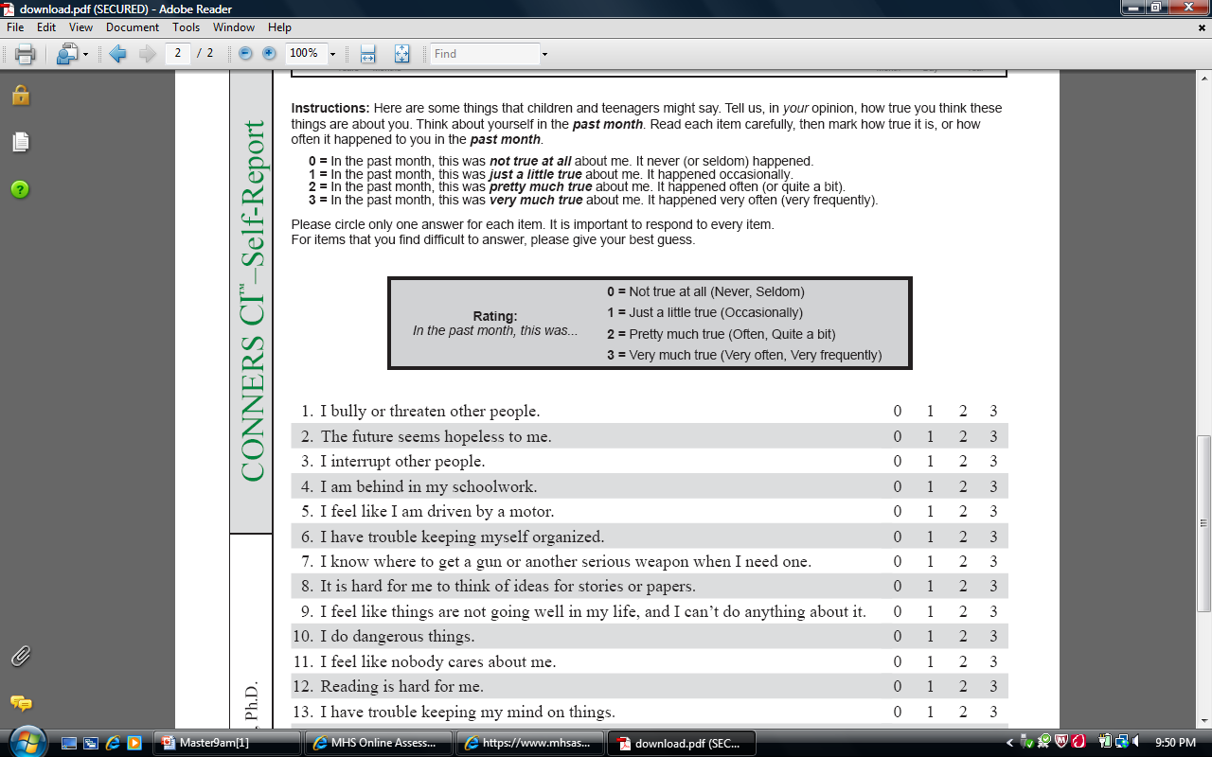

Slide 75
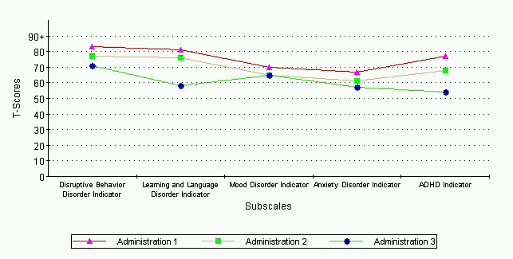
Conners: Administration
Can be administered individually or in a group
Estimated time completion: 5 to 10 minutes
Can be administered via a link sent by email: https://www.mhsassessments.com/MAC/login.aspx?fid=629cc90-8ab6-4724-a416-bbc67d34be1ef
Can be used as a progress monitoring tool

Slide 76
Conners: Scoring
Paper and pencil scoring with the QuickScore form
Computer scoring
USB
Online
Items are endorsed using a 4-point Likert like scale
0 = Not true at all (Never, Seldom); 3 = Very much true (Very Often, Very Frequently)
Estimated time completion: 10 minutes

Slide 77
Conners: Interpretation
T-Score | Percentile | Guideline
70 + | 98 | Very Elevated Score (Many more concerns than are typically reported)
65-69 | 93-97 | Elevated Score (More concerns than are typically reported)
60-64 | 84-92 | High Average Score (Slightly more concerns than are typically reported)
40-59 | 16-83 | Average Score (Typical levels of concern)
<40 | <16 | Low Score (Fewer concerns than are typically reported)

Slide 78
Standardization and Norms
Sample was stratified to represent the U.S. population at the 2000 census
n =3400
Normative sample was taken from across the U.S. Northeast, West, Midwest, South and parts of Canada
Developed using the Conners Behavior Rating Scale pool

Slide 79
Psychometric Properties
Please refer to handout for specific numbers
Internal Reliability | Limited to Adequate
Test-Retest Reliability | Excellent
Inter-rater Reliability | Adequate
Convergent/Divergent Validity | Limited to Excellent

Slide 80
Conners: Advantages
Designed for use in a clinic or school setting
Can be used for progress monitoring
QuickScore scoring form
Convenient computer scoring system
Links for forms can be emailed for completion
Spanish version available

Slide 81
Conners: Disadvantages
Manual is housed within the Conners CBRS manual
Seems to be more clinically focused
Oriented toward problem behaviors, does not include adaptive behaviors
Potentially high cost
Internal consistency reliability is variable
Validity is variable

Slide 82
Strengths and Difficulties Questionnaire; SDQ
http://www.sdqinfo.org/
Presented by Amy Magers

Slide 83
SDQ: Overview
Brief questionnaire with the primary purpose of screening for behavioral concerns for students of
ages 4-17
Accessed via the internet and all materials are downloadable
Norm-referenced and available for use in over 40 languages
Useful for screening, initial clinical assessment, treatment follow-up, and research purposes

Slide 84
SDQ: Cost
Free

Slide 85
SDQ: Administration
Can be given on paper or online
Time for completion: 5 minutes per child (when online, includes report)
Individual rating by teacher, caregiver
Group self-assessment for ages 11-17
25 standard questions
“Impact Supplement” (questions on severity, duration, etc.)
Ratings are given on 3-point Likert scales: “Not true,” “Sometimes true,” and “Certainly true”

Slide 86
Using the SDQ
Three key websites:
For research, general information, downloads,
http://www.sdqinfo.org/
For scoring paper versions,
http://www.sdqscore.org/
For online assessment and reports,
http://www.youthinmind.info/

Slide 87
Online Assessments and Reports

Slide 90
SDQ: Scoring
Designed to predict how likely a child is to have emotional, behavioral or concentration problems severe enough to warrant a diagnosis according to DSM-IV classifications
Scores obtained: Range “very low” to “very high” over 5 domains:
Emotional problems
Conduct problems
Hyperactivity/ inattention problems
Peer relationship problems
Prosocial behavior

Slide 91
SDQ: Scoring
Scoring can be completed manually on downloaded forms, or online (recommended)
No database to save results or make local comparisons
Website includes downloads for scoring via statistical software program
SPSS, SAS, STATA

Slide 92
Entering Data: http://www.sdqscore.org

Slide 94
SDQ: Interpretation
The scores are grouped into four bands based prevalence in the general population:
80% of children score 'close to average'
10% score 'slightly raised‘
5% score 'high'
5% score 'very high'.
The exception is the scale for kind and helpful behavior, with roughly 80% 'close to average', 10% 'slightly low', 5% 'low' and 5% 'very low'

Slide 95
Readable Report: http://www.youthinmind.info/
 | VERY HIGH for overall stress
 | Close to average for worries, fears or sadness
 | VERY HIGH for troublesome behavior
 | VERY HIGH for overactivity and lack of concentration
 | SLIGHTLY RAISED for difficulties with other children
 | SLIGHTLY LOW for kind and helpful behavior
Notes:
Youthinmind-technical and readable (parent-friendly)

Slide 96
Standardization and Norms
British sample of:
n = 7,313 teachers
n = 9,998 parents
n = 3,983 students
Information on ethnicity and gender is not available
Evidence for an alternate factor structure for use in the U.S.
(Dickey & Blumberg, 2004)
Notes:
Internalizing, externalizing, and prosocial NOT conduct and hyperactivity/inattention

Slide 97
Psychometric Properties
Please refer to handout for specific numbers
Internal Reliability | Adequate
Test-Retest Reliability | Adequate to Excellent
Inter-rater Reliability | Adequate
Convergent/Divergent Validity | Excellent
Notes:
Limited-student/self-report, adequate-parent, excellent-teacher

Slide 98
SDQ: Advantages
Free to use and download; costs only in printing materials
Brief-5 minutes per student
Easy to administer, score, and interpret
Can be used online or off
Pre/post comparisons
Report generation
Notes:
Pre-post-on consulting a counselor who frequently uses the SDQ, he found this to be a great measure to determine efficacy of therapy sessions

Slide 99
SDQ: Disadvantages
Takes time to become familiar with website(s)
Cannot save entered scores online
Use statistical programs?
Not part of a larger diagnostic or intervention program
No manual
Report generation
All-British normative group

Slide 100
Conclusions and Wrap up Questions?

